Slide 1

Inventory
Sales Performance
Analysis

Slide 2

Information About Data:-
Data from January 2022 to September 2023
1.products & purchases
2.Store details
3.Purchase prices
4.Product names
5.Product dates
6.Sales and units etc…

Slide 3

Goal Analysis:
1. Production Performance Analysis
2. Store Performance Analysis
3. Complex Monthly Sales Trend Analysis
4. Cumulative Distribution of Profit Margin
5. Store Inventory Turnover Analysis

Slide 4


PROCESS
1
IMPORTING DATA
2
DATA TYPE-CHECKING
3
DATA CLEANING
4
UPDATING CONSTRAINS
5
SOLUTION BUILDING

Slide 5
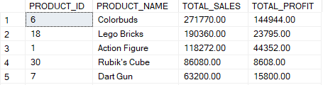

Insight Discussion
1. Production Performance Analysis
i)Top Performer : "Colorbuds" has the highest total sales ($271,770) and the highest total profit ($144,944), making it the most profitable product.
ii)Lego Bricks has the second-highest sales ($190,360) but a relatively lower profit margin ($23,795).
iii)Action Figure has decent sales ($118,272) and a moderate profit ($44,352).

Slide 6
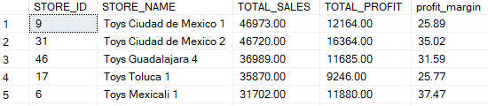
Insight Discussion
2. Store Performance Analysis
i)Top Sales Store : " Toys Ciudad de Mexico 1" has the highest total sales ($46,973) but a moderate profit margin (25.89%).
ii)Highest Profit Margin : " Toys Mexicali 1" has the highest profit margin (37.47%) despite having the decent sales of ($31,702), indicating good pricing.
iii)Best Overall Performer : "Toys Ciudad de Mexico 2" has strong sales ($46,720) and a good profit margin (35.02%), making it one of the most efficient stores.

Slide 7
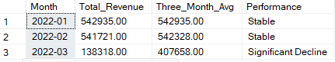
Insight Discussion
3. Complex Monthly Sales Trend Analysis
i)Stable Sales in Jan & Feb 2022 :
• January ($542,935) and February ($541,721) had nearly identical revenues, maintaining stability.
• The rolling 3-month average remained around ₹542,328, reinforcing consistent performance.
ii)Significant Decline in March 2022 :
• Revenue dropped sharply to $138,318.
• The 3-month average fell to $407,658, reflecting a drastic downturn.
• This suggests a major disruption, possibly due to market conditions, seasonality, or operational challenges.

Slide 8
Insight Discussion
4. Cumulative Distribution of Profit Margin
i)Top Profit-Contributing Categories:
Art & Crafts leads in cumulative profit margin, with high-margin products like Playfoam (63.63), Barrel O' Slime (50.00), and Etch A Sketch (47.61) boosting the total margin significantly.
ii)High-Profit Margin Products:
Jenga (70.00), Mini Basketball Hoop (64.00) and Playfoam (63.63) are among the top individual profit margin contributors.
iii)Consistently Growing Cumulative Margin:
• The cumulative margin steadily increases, reflecting profitable product choices.
• Almost in most of the product, the margin surpasses 200, indicating a strong contribution from premium-priced or high-margin items.

Slide 9
Insight Discussion
5. Store Inventory Turnover Analysis
i)Top-Performing Stores (Higher Efficiency Percentage):
• Store 9 has the highest Inventory Turnover Efficiency (100%), meaning it turns over its inventory at an optimal rate.
• Store 14 (69.07%) and Store 16 (62.17%) also have strong efficiency, indicating they effectively manage stock levels.
ii)Moderate Efficiency Stores (40-60% Range):
• Stores like Store 2 (50.04%), Store 8 (53.80%), and Store 28 (54.49%) show good inventory turnover but may have room for optimization.
iii)Low-Performing Stores (Below 30% Efficiency):
• Store 35 (20.18%), Store 30 (22.88%), and Store 20 (28.18%) struggle with slow inventory turnover, possibly due to overstocking or low demand.

Slide 10

Business Recommendations:
Focus on High-Profit Products
• Prioritize stocking and promoting high-margin products like Uno Card Game, Jenga, and Playfoam, which contribute significantly to overall profitability.
Optimize Store Inventory Efficiency
• Improve inventory turnover efficiency in stores with lower ratios by adjusting stock levels based on demand patterns to reduce holding costs.
Address Sales Decline Trends
• March 2022 showed a significant revenue drop; investigate possible causes like seasonality or supply issues and implement targeted promotions or demand forecasting.

Slide 11
Business Recommendations:
• Stores with low efficiency (<30%) should analyze demand patterns and adjust stock levels accordingly.
• Highly efficient stores (above 60%) indicate strong sales and inventory control but may need to monitor stockouts.
• A balanced inventory turnover ratio (40-60%) is ideal for maintaining both efficiency and availability.

Slide 12

THANK YOU

